Slide 1
LIBS 7001 Week 4: Definition and Classification
identify, discuss, use and evaluate concepts and techniques of
  definition, including
    connotation and denotation
    synonyms
    essential and extended definitions
  classification, including principles of classification and overlapping
general material adapted from: Reinking, J., et al., Strategies for Successful Writing (2004), text (SSW) & 7001 instructor’s manual (IM)

Slide 2
Definition: an Overview
    credibility trustworthiness believability
    content information knowledge
    melancholy homesickness nostalgia
Defining: “identifying features that distinguish a term, thereby putting a fence around it, establishing boundaries, and separating it from all others” (SSW, 135)
an interesting, sometimes elusive process; 2 approaches:
  denotative definitions: purport to be objective
  connotative definitions: associative

Slide 3
Denotation and Connotation
from Merriam-Webster’s dictionary:
  denotation: to mark out plainly; all that belongs to the definition of the word
  connotation: all the ideas that are suggested by the term
  “home”
    = one’s dwelling place; native land
    can suggest comfort, intimacy, security, affection

Slide 4
Connotative or Denotative?
(Ambrose Bierce, The Devil’s Dictionary, (1881-1906)
BACK, n. That part of your friend which it is your privilege to contemplate in your adversity.
BIGOT, n. One who is obstinately and zealously attached to an opinion that you do not entertain.
FROG, n. A reptile with edible legs.
PATIENCE, n. A minor form of despair, disguised as a virtue.
ERUDITION, n. Dust shaken out of a book into an empty skull.

Slide 5
Types of Connotation, cont.
same word, different meanings
  rose
  cape
  play
different words, same denotative meanings, but different connotations:
  cheap _______________________
  inexpensive _______________________
  deception _______________________
  fib _________________

Slide 6
Centrality of Definition
for Plato (4th c. BCE philosopher), “knowledge is attained only when humans recognize the true nature of virtue and the good” (IM, 48) -- that is, define them, and distinguish them from all others
  example: Euthyphro attempts to define the concept of “piety”…but does not succeed!
Defining is a basic philosophical technique, not a simple consultation of a dictionary.
Definition types: synonyms, essential, extended

Slide 7
(1) Synonyms
(SSW, 135)
words with very nearly the same meanings
  lissome nimble
  worthy suitable
not identical twins -- have different shades of meaning:
  “protest” is not = “object”
convenient and helpful, but limited in precision
beware the thesaurus!

Slide 8
(2) Essential Definitions
(SSW,136-37)
go back to the Greeks, esp. Plato (IM, 48), who with Aristotle structured much of the way we think in western culture
do three things, in sequence:
  1. names the item being defined A voiceprint
  2. places it in a broad category is a graphical record
  3. distinguishes it from other items of a person’s
  in that category voice characteristics.

Slide 9
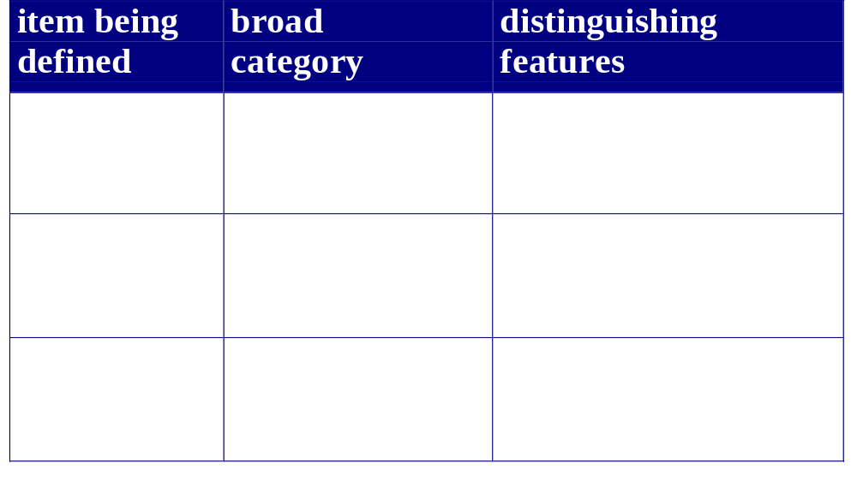
Essential Definitions, cont. (p 137)

Slide 10
Essential Definitions: Limitations
can’t do full justice to abstract terms (justice, love) or to words which have several meanings (jam). Also, avoid:
  circular definition
  A psychiatrist is a physician who practices psychiatry
  overly broad definition
  A skunk is an animal with … black fur & white markings
  overly narrow definition
  A kitchen blender is a bladed appliance used to chop foods
  omission of main category (“is where” / “is when”)
  A bistro is where food is served

Slide 11
(3) Extended Definitions
(SSW, 137-39)
go beyond essential definitions -- can be a paragraph, or entire paper
useful when you’re defining new terms and terms with more than one meaning
“fundamental to your career and your life” (138)
  search and seizure
  human rights
  speed limit
use many different methods of development

Slide 12
Writing an Extended Definition
Choose an abstract term or one that is concrete but unfamiliar to your reader -- e.g., “computer virus” but not “table”.
Follow an ordered process in composing this type of definition, involving
  brainstorming
  testing
  evaluating methods of development
  charting your chosen methods
  carefully drafting and revising (SSW, 140-42)

Slide 13
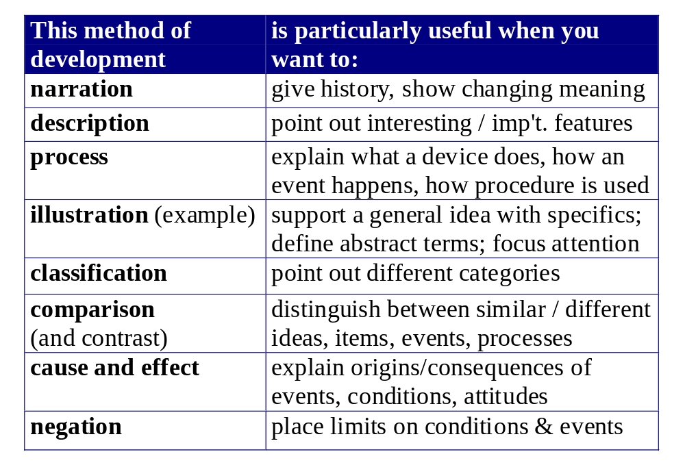

Slide 14
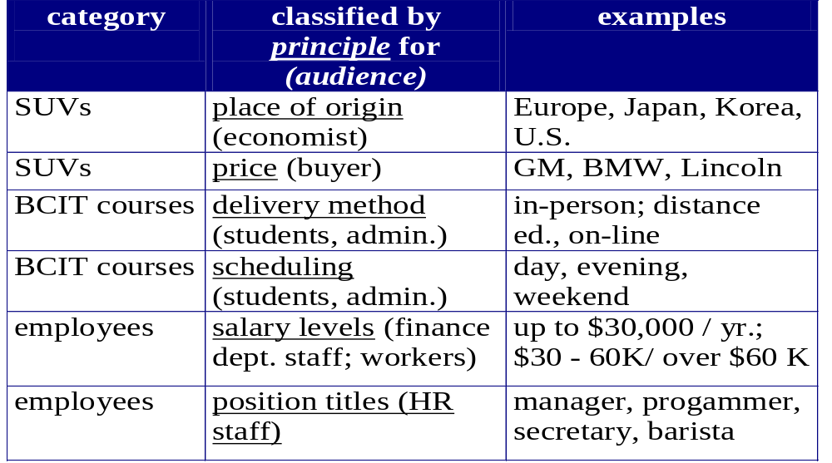
Classification - introduction

Slide 15
Classification
(SSW, 100-109)
helps writers and readers come to grips with large and complex topics
breaks down broad topics into categories according to a specific principle
presents distinctive features of each category
shows how features vary among categories
is a common feature of daily life; helps people make choices.
When does classification become limiting?
  When can it be humorous?

Slide 16
Selecting and Developing Categories
Choose a principle of classification suited to purpose and audience
Divide one or more categories into subcategories -- but not too many!
Avoid overlapping categories
Develop each category with specific, informative details

Slide 17
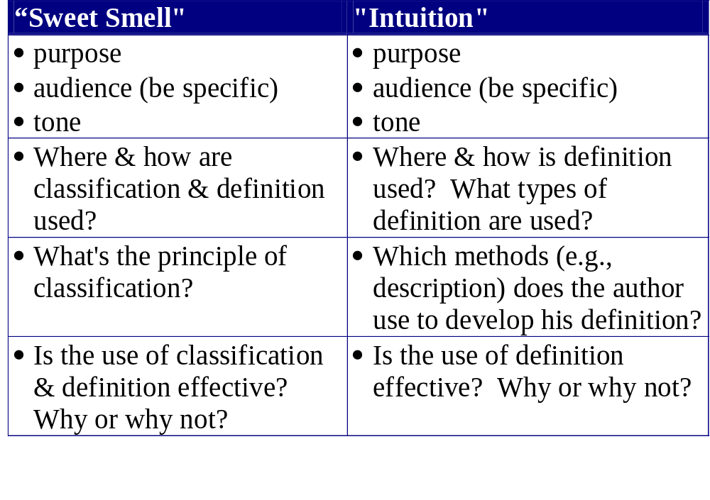

Slide 18
Essay Review
Chapters 2-3, 14-15
PP. 27, 39, 50
PP. 187, 190, 199
P. 221
What goes in a Thesis Paragraph? (pp 26-27)
  Thesis statement, “Thesis Map”
  General Background, Intro Material
  “Attention Getter”

Slide 19
© BCIT
Based on LIBS 7001 Instructors’ Guide and material by Liotta, Homel, Kelly, and other members of the BCIT Liberal Studies Dept.

